Slide 1
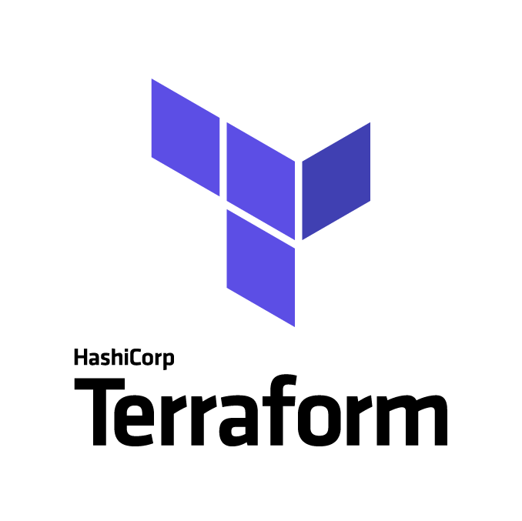
Terraform, Infrastructure As Code

Slide 2
Agenda:
What’s Infrastructure As Code (IaC)
What is Terraform and how does it work
A real example live

Slide 3
Let’s talk about :
Infrastructure as Code
Notes:
In the past, software delivery would follow this sort of pattern: - A System Administrator would setup up a physical server and install the operating system, patch the machine and install all the necessary software to run your application - Then a Database Administrator basically do the same - And you repeat the operation for the test and production environment - The developer would deliver the code by copying it to the test machine, Once the new code had gone through the entire test procedure on the test machine, you can deploy it in production right ?. Do you thnk this worked 100% of the time ?

Slide 4
The Benefits
Auditable
Repeatable
Dependable
Because going through hundreds of different buttons and screens on your cloud provider's web UI isn't the kind of thing that's easy to replicate 100% accurately
If you can’t audit and repeat the actions that built your infrastructure, you can’t depend on your infra
It's easier to audit code than physical infrastructure
Notes:
Basically all the advantages of code you can think of but replicated for your infra

Slide 5
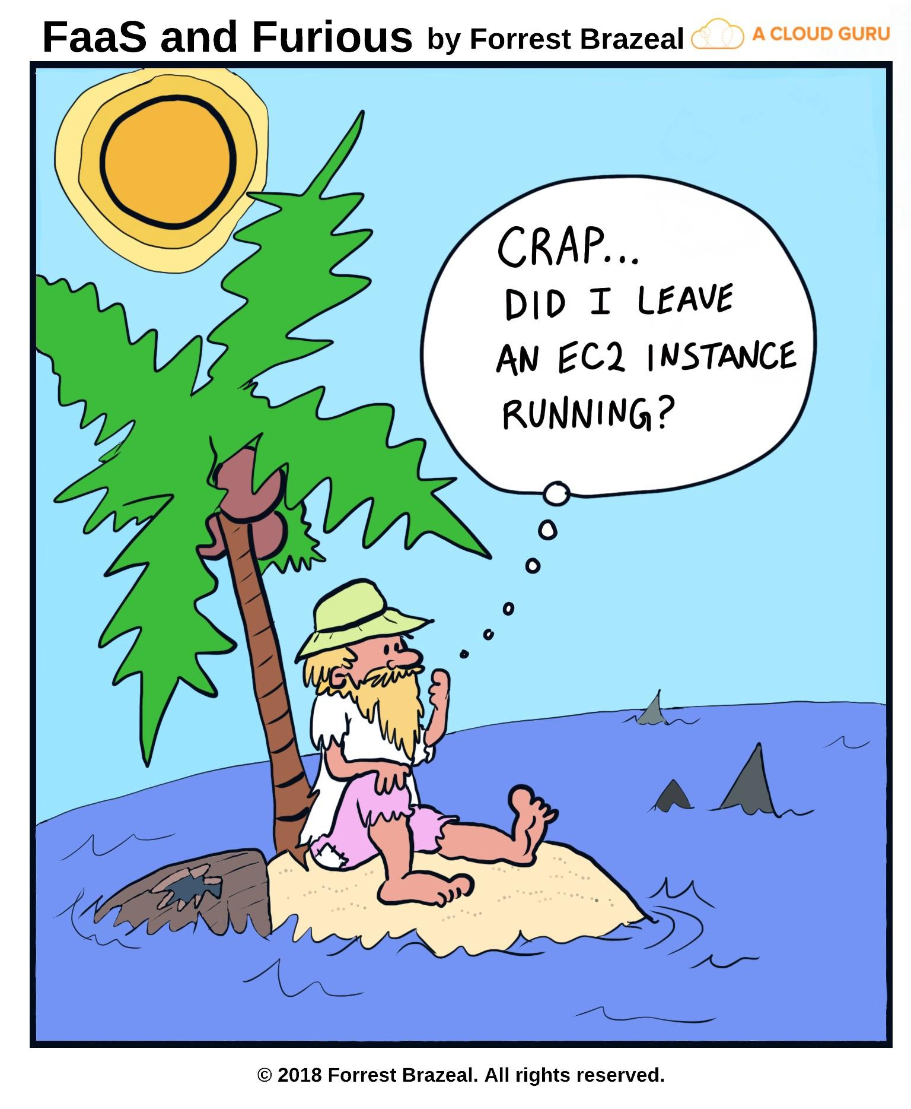
https://read.acloud.guru/acg-faas-and-furious-b9574b6675c5

Slide 6
Advantages of IaC
It’s code, so you can work on it just like your application
Versioning
Easy to collaborate on
Easy to integrate in a CI setup (it’s code after all)
Automate your deployment and recovery processes
No need to repair, just redeploy
Etc.
Notes:
Basically all the advantages of your code but for you infrastructure

Slide 7
What’s Terraform ?
Terraform is a tool for provisioning infrastructure, from low-level components such as virtual machines, storage and networking, to higher-level components such as DNS entries.
A tool by HashiCorp
Notes:
Terraform is a tool developed in Go
You might now other tools form HashiCorp, mainly Vagrant or Vault
With Terraform, you use configuration files to describe the components needed to run your application (or applications), such as web servers, database instances, DNS, user roles etc. Terraform is not a configuration management tool, for those that already have used tools like Chef or Ansible, Terraform is not the same thing. Configuration management tools install and manage software on a machine that already exists Terraform focuses on the higher-level abstraction of the "datacenter" if you want.

Slide 8

Terraform is :
Open Source
Multi vendor
Yeah Open Source !
It’s available on Github
95 different providers supported (as of 05.02.2018), not counting community providers
Notes:
Terraform supports more than just cloud providers. In total, terraform supports natively 95 different providers (as of 05.02.2018). Ranging from cloud providers such as AWS to VCS such as Github or bitbucket.
You can manage some monitoring & system management services such as Grafana, StatusCake, DataDog etc.
But there are also some "Community Providers", built by the community of Terraform users and vendors. They are not maintained by HashiCorp.

Slide 9
What is HCL?
What’s HCL ?
Creating resources
Edit existing resources
HashiCorp Configuration Language
What it looks like, how does it work, why
Creating things is good
Let’s create virtual machines in the cloud for fun and profit
Make things better
If it’s not broken, break it and make it better

Slide 10
What makes Terraform, Awesome?
Make it reproducible
Delete everything
Chai Time
The greatness of IaC
Let’s create a new workspace and make a copy of our infrastructure
Nuke from orbit
Let’s destroy the entire infrastructure we created
Let’s talk around a drink Chai
Let’s talk cloud infrastructure, the web and different Chai preferences

Slide 11
What’s HCL (HashiCorp Configuration Language) ?
HCL is a configuration language built by HashiCorp.
Designed to be written and modified by humans
Designed to allow JSON as an input so that it is also machine-friendly
resource "aws_instance" "example" { ami ="${data.aws_ami.latest-ubuntu.id}" instance_type = "t2.micro" }
Notes:
HCL is also fully JSON compatible. That is, JSON can be used as completely valid input to a system expecting HCL. This helps makes systems interoperable with other systems.
If you’ve ever written nginx configuration files, it’s fairly similar

Slide 12
What’s next?

Slide 13
Some prerequisites
Install Terraform (Obviously)
An AWS account (for our use case)
An AWS user with an Access key and a secret key
Install the AWS CLI
This is already setup as this is not very interesting
Notes:
For this I guess some simple google-fu is necessary, I won't get into the details for this, I'll focus on terraform

Slide 14
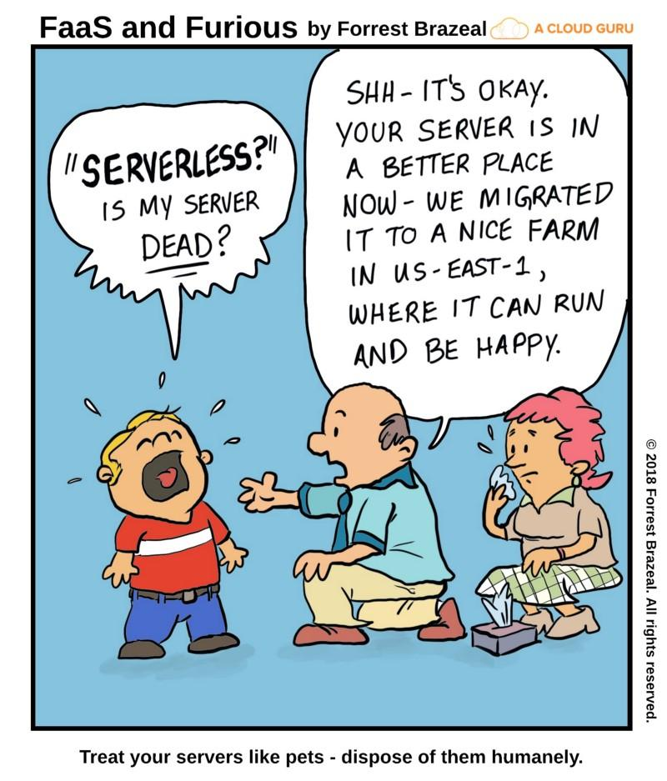
Thank You !

